Slide 1


Current situations and their solutions.

Slide 2
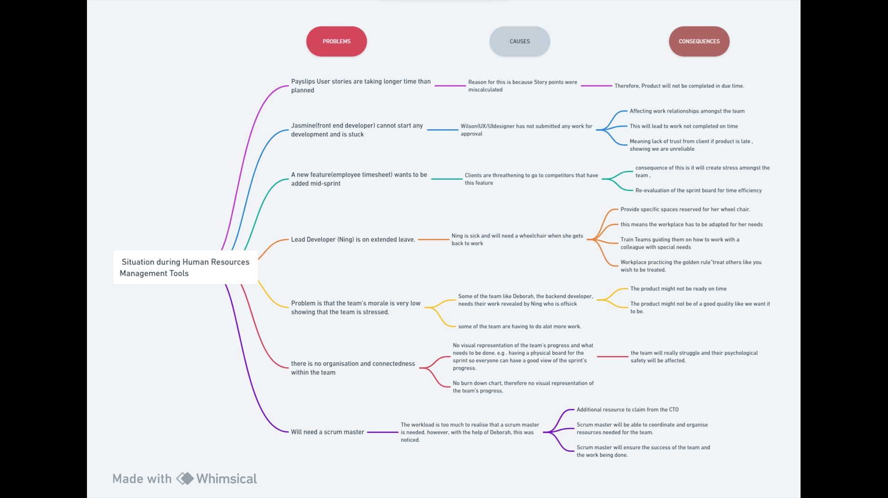

Slide 3
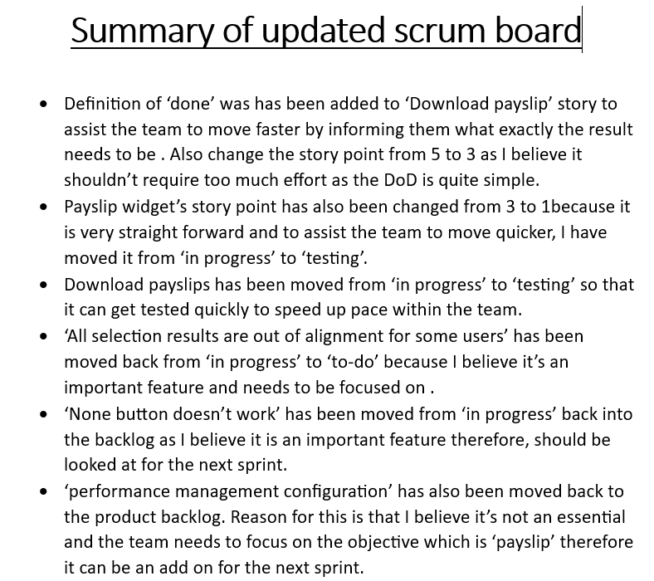
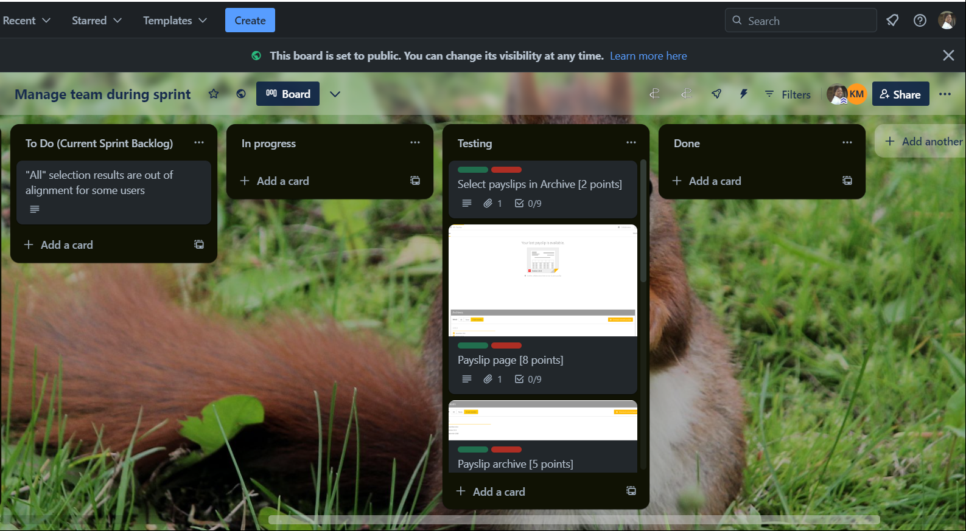
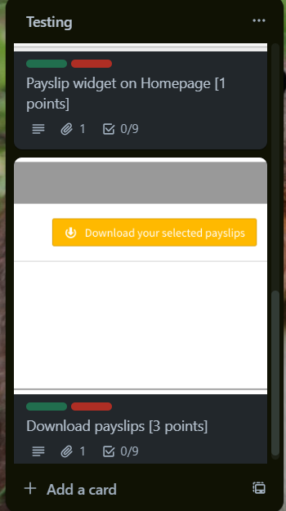
Updated sprint board

Slide 4
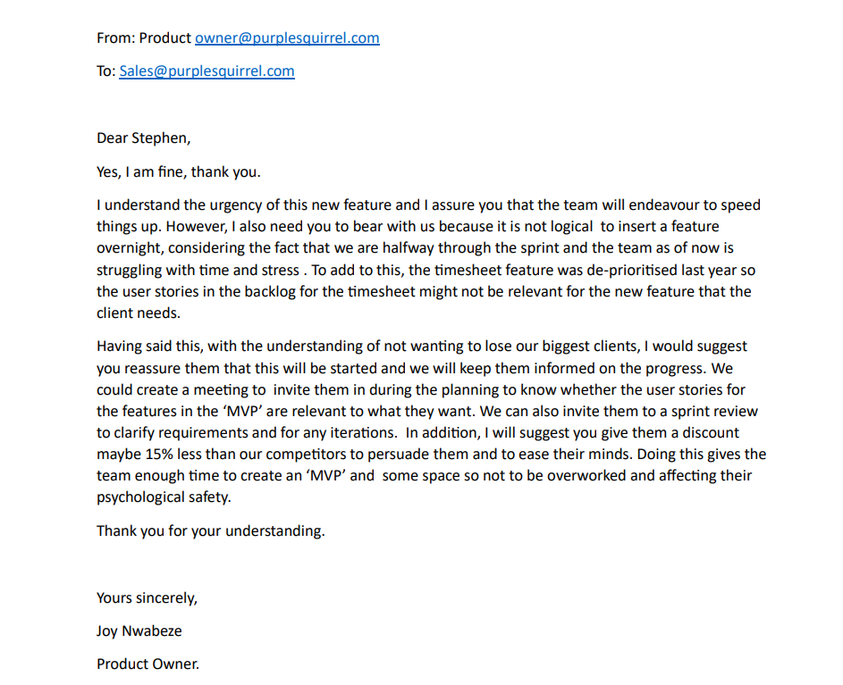


Response to Stephen’s email

Slide 5
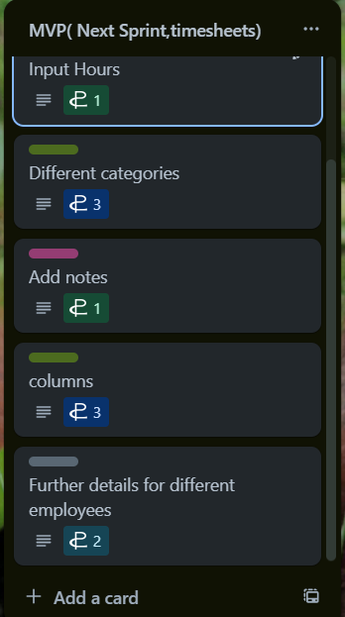
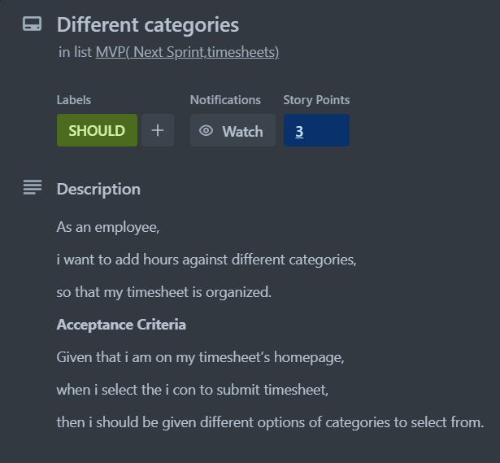

MINIMAL VIABLE PRODUCT(MVP) (version of a product with enough features to satisfy early customers and provide feedback for the future product development)

Slide 6
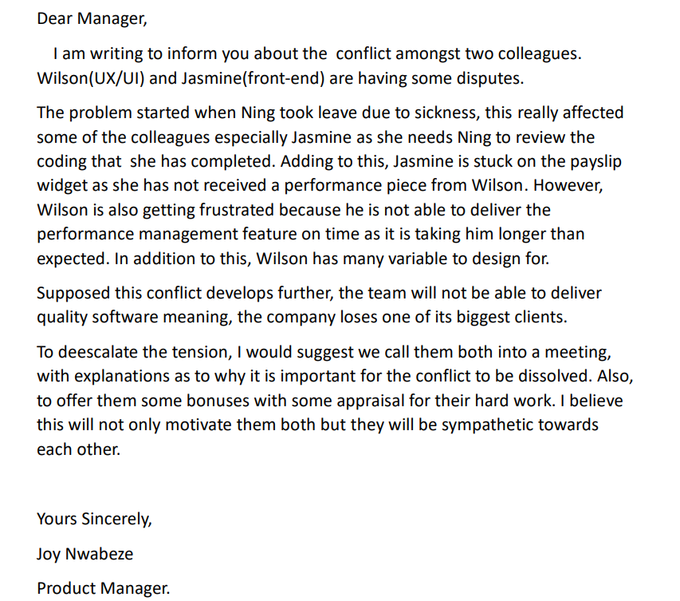
Conflict at work

Slide 7
IDEAS | ACTIONS | CONSEQUENCE
Supporting Cooperative Management | Draw a physical Trello board Draw a burndown chart | Team actively make decisions collectively. Visual representation of progress with constructive feedback amongst eachother
Encouraging taking initiative and individual creativity. | Collectively create definition of done. Create a checklist of activities and whom task is assigned to. | Promotes critical thinking boosting creativity amongst the team Improves self-reflection on improvements forcing team to take initiative with pre-emptive planning.
Promoting Collective Intelligence | Implement the mob programming approach. Team decides the acceptance criteria collectively | Promotes bonding, communication, team alignment and whole team involvement. Permits effective calculation of story points.
Taking Ning’s needs into account | Company creates a ramp access Implement rules. | Gives Ning freedom to gain access into the building/office. Disability awareness deters bullying in the workplace.
LIST OF IDEAS AND ACTIONS TO IMPROVE TEAMWORK

Slide 8
